Slide 1
初階影像處理、嵌入式機器人視覺 及人機互動 Homework 3
TA:
林超：423838819@qq.com
黃梅琇 : illya50947@gmail.com
尹心忠 : yinagfa081922@yahoo.com.tw
吳中銓 : f74012227@gmail.com
Office Hour: 15:00~17:00, Tue.

Slide 2
注意事項一
嚴禁抄襲!! 發現兩份一樣則兩份都以零分計算
若批改時不能執行，一週內自行來實驗室demo，否則以零分計算!!!
Deadline => 1 / 18 (三) 中午12:00
-不接受補交，遲交一律0分
作業上傳位置 => 140.116.154.1 -> Upload/Homework/OpenCv_Hw3
-帳號:OpenCv 密碼: OpenCv
繳交格式
-檔名：Hw3_學號_名字_版本.rar
Ex: Hw3_F71234567_林小明_v1.rar
-內容：整個專案(含圖片和影片) (但是不要把Debug資料夾也裝進來這樣檔案很大)

Slide 3
注意事項二
OpenCV 2.4.7 is on ftp
Visual Studio 2012 is on http://www.cc.ncku.edu.tw/download/

Slide 4
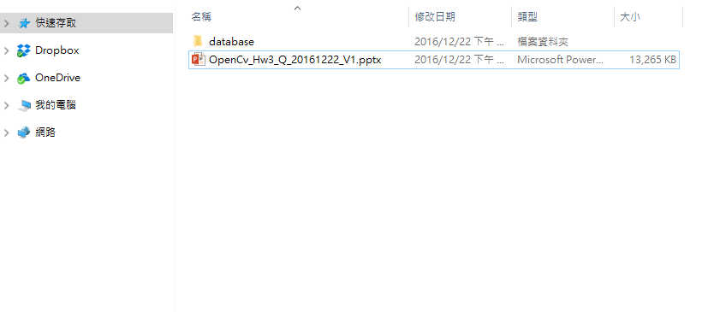
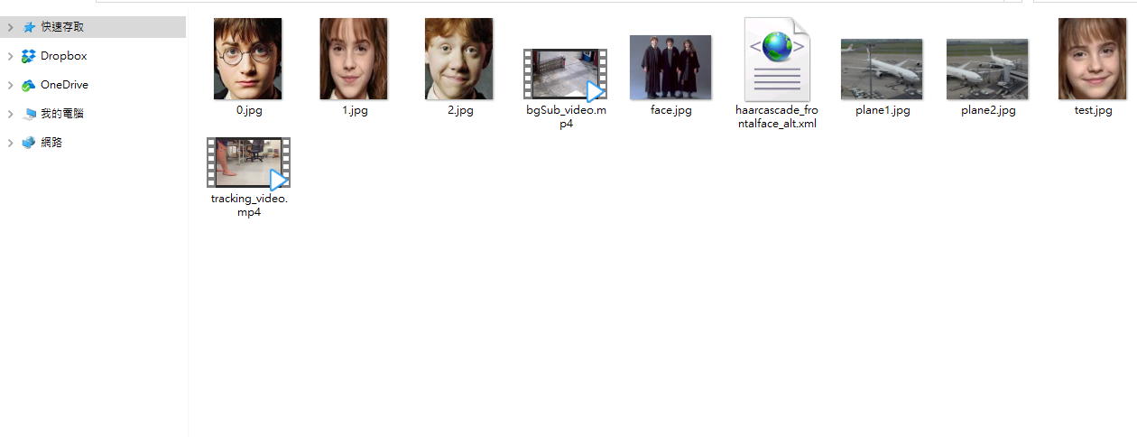
Homework Resources
Folder “database”: includes image files plane1.jpg, plane2.jpg, 0.jpg, 1.jpg, 2.jpg, test.jpg, and face.jpg ; video files bgSub_video.mp4, tracking_video.mp4 ; xml file haarcascade_frontalface_alt.xml
Folder “hw3”
Folder “database”

Slide 5
Grading:
1. (10%) Homework Format
2. (20%) SIFT
3. (20%) Background Subtraction
4. (20%) Optical Flow tracking
4.1 Preprocessing (10%)
4.2 Tracking whole video (10%)
5. (30%) Face Recognition & Detection
5.1 Face Recognition (10%)
5.2 Face Detection (10%)
5.3 Face Detection + Recognition (10%)

Slide 6
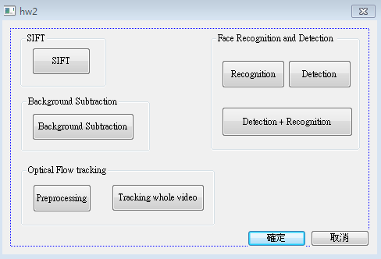
1. (10%) Homework Format
使用 MFC 實作下方介面

Slide 7
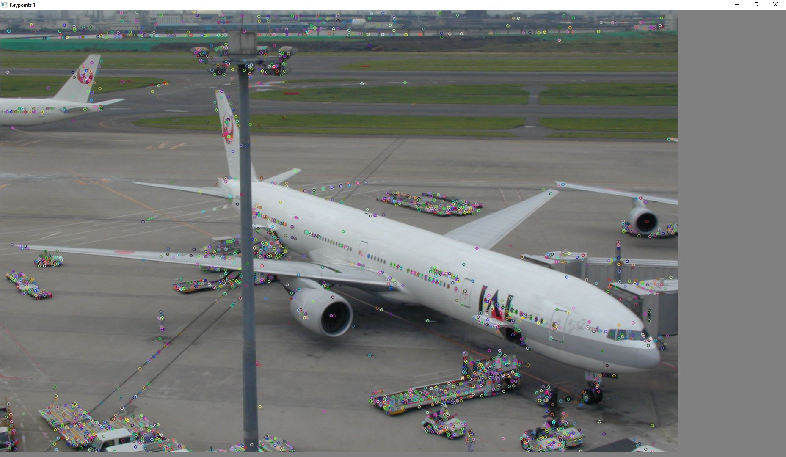
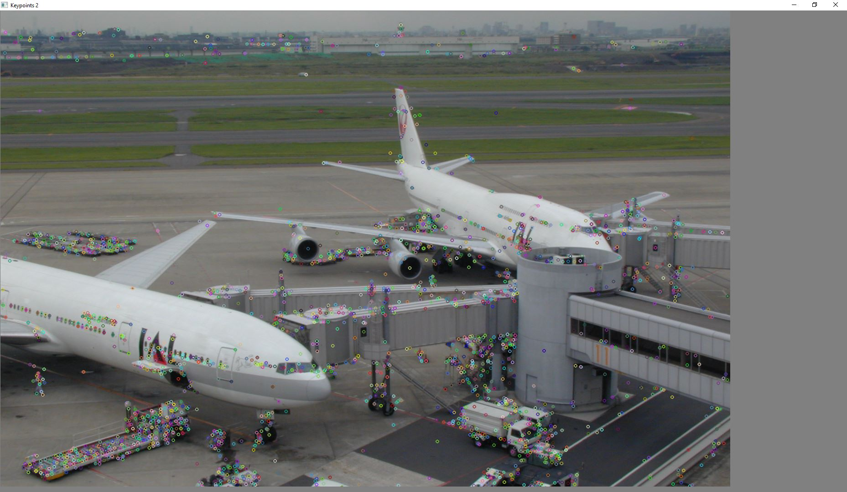
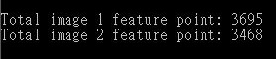
2. (20%) SIFT
Find feature points on the two images (plane1.jpg, plane2.jpg)
(15%) Draw every feature point on the two images and show the result
(5%) Output the number of feature points of each image on the console window
Hint : (ref. : opencv2refman_2.4.7.pdf) ref. P663 ~ P670
SiftFeatureDetector, drawKeypoints
示意圖:

Slide 8
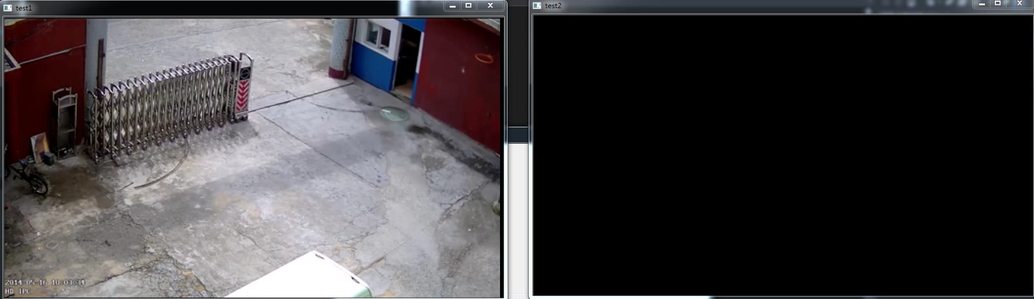
3. (20%) Background Subtraction
讀取影片 (bgSub_video.mp4)並提取出該影片的 foreground
1) (20%) 在兩個視窗分別播放原影片以及提取出 foreground 的影片
Hint : (ref. : opencv2refman_2.4.7.pdf) ref. P372 ~ P376
示意影片:

Slide 9
4. (20%) Optical Flow tracking
4.1 Preprocessing (10%)
4.2 Tracking whole video (10%)

Slide 10
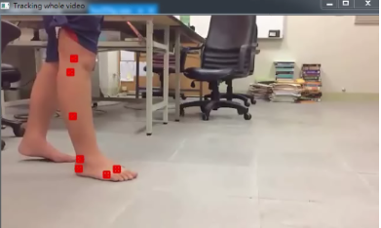
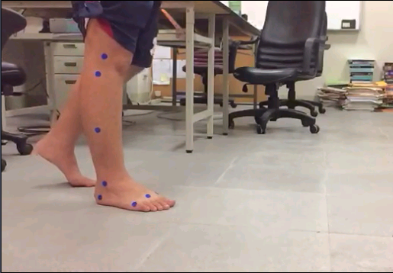
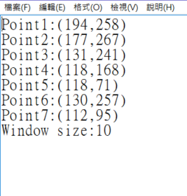

4.1 Preprocessing (10%)
讀取影片 (tracking_video.mp4) 並自行決定7個追蹤點的 initial position 和 window size
(5%) 將7個追蹤點的 initial position 和 window size存在 (hw3_1.txt檔)
(5%) 並在第一個frame上顯示出來
示意圖:
x
hw3_1.txt
(0,0)
window size
y

Slide 11
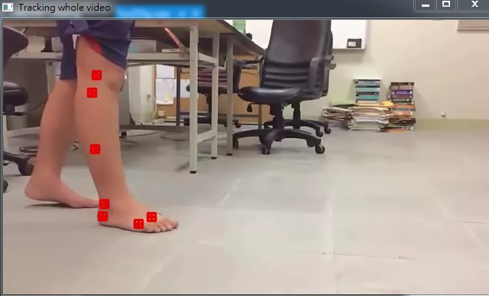
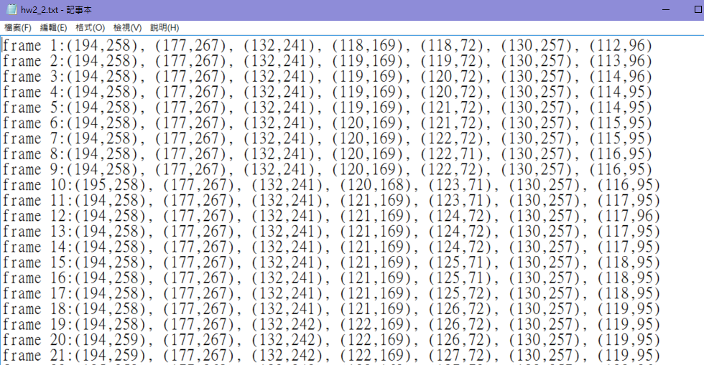
4.2 Tracking whole video (10%)
事先追蹤完整個影片的追蹤點，並將全部的點存在一個txt檔(hw3_2.txt檔)，然後讀取 (hw3_2.txt檔) ，並將那些點畫在原影片上，並連成一個軌跡圖
Hint: OpenCV Textbook Chapter 10 (P332 ~ P334)
hw3_2.txt
示意影片:
※追蹤過程中可能會追蹤失敗，需要重新校正，可在某些frame手動調整點的位置，再重新追蹤

Slide 12
5. (30%) Face Recognition & Detection
5.1 Face Recognition (10%)
5.2 Face Detection (10%)
5.3 Face Detection + Recognition (10%)

Slide 13

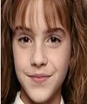

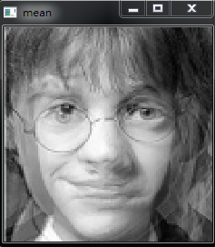

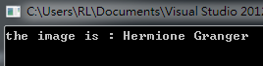
5.1 Face Recognition (10%)
training data: (100*120)
0.jpg
1.jpg
2.jpg
Harry Potter
Hermione Granger
Ron Weasley
Given three face images (0.jpg ~ 2.jpg), use eigenface to recognize the faces
1) (5%) Show the result of the mean face
2) (5%) Given a test image (test.jpg), show the name of the person on the console
window
Hint: (ref. : opencv2refman_2.4.7.pdf) ref. P681 ~ P743
class FaceRecognizer
Output format:
test data:
(100*120)
test.jpg
Hermione Granger

Slide 14
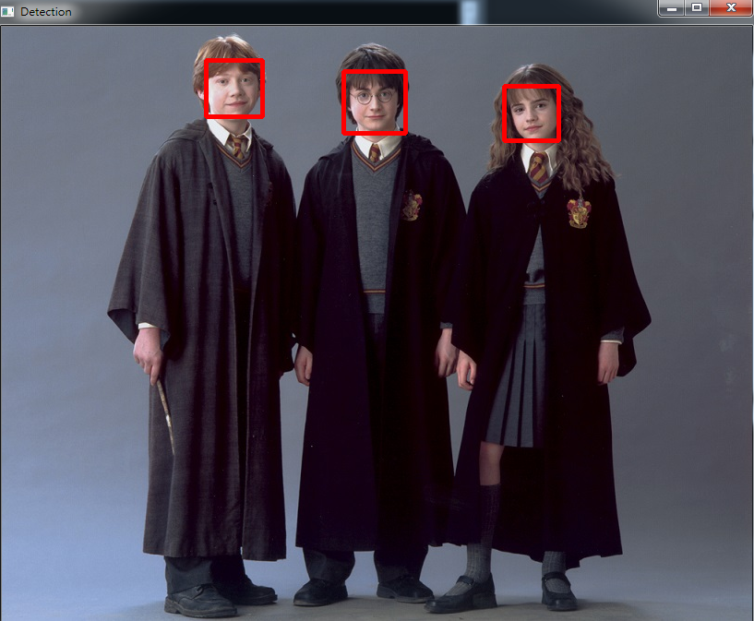
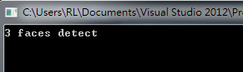
5.2 Face Detection (10%)
Given a image (face.jpg), detect the faces on the image by using Adaboost
1) (5%) Output the number of faces detected on the console window
2) (5%) Draw a rectangle on each face, and show the result
Hint: (ref. : opencv2refman_2.4.7.pdf) ref. P447 ~ P453
class CascadeClassifier
Output format:

Slide 15
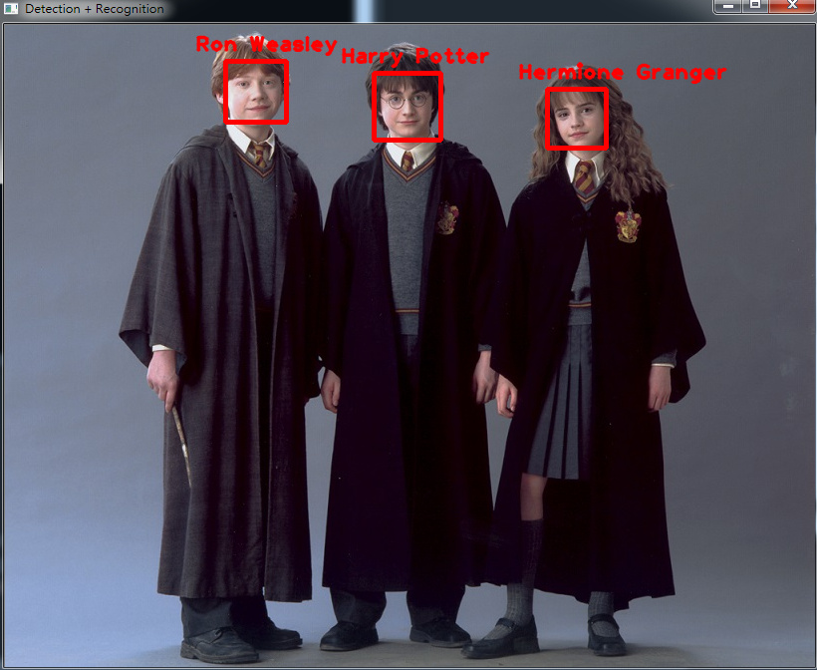
5.3 Face Detection + Recognition (10%)
Use the result of detected faces in 5.2, and recognize them.
1) (10%) Show the name of each person.
Output format:

